Slide 1

Predicting Road Accident Severity
with Machine Learning Paradigms
Joshua Khoo
Joel Mui Kit
Ethan Ong Sze Rey
Brandon Quek
Lim He Ying
U2021421C
U2010877H
U2010183H
U2011292D
U2011832J

Slide 2
Executive Summary
Recommendations
Introduction
Causality Analysis
Data Exploration
Predictive Models
Conclusion
Ethan

Slide 3
Business Problem
“Transport is one of the most important factors in making the UK Prosper.”
- Patrick McLoughlin
Secretary of State for Transport
Ethan

Slide 4


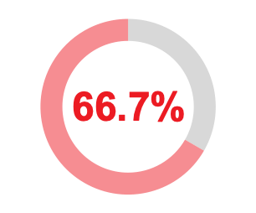
Business Problem
Road Usage Statistics (2019)
Passenger Journeys
2%
35.6 Billion
Vehicle Miles
Freight Transported
Ethan

Slide 5
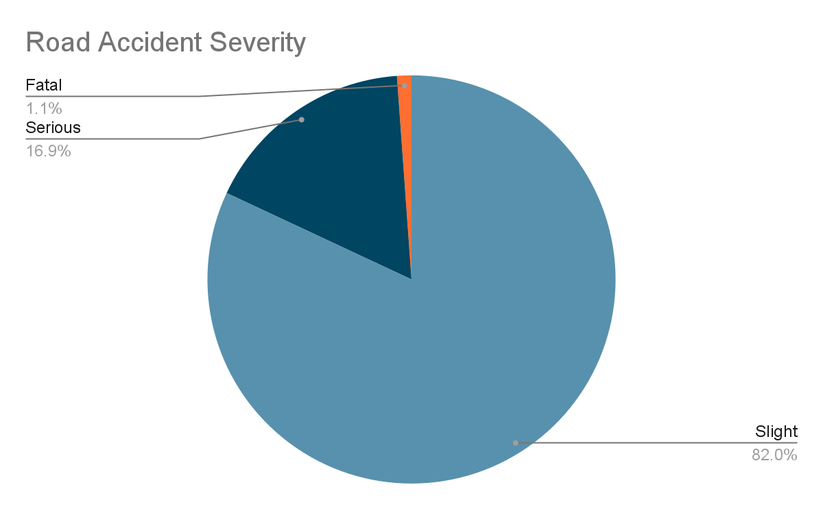

Business Problem
Road Accident Statistics (2019)
153,158
Casualties
Ethan

Slide 6
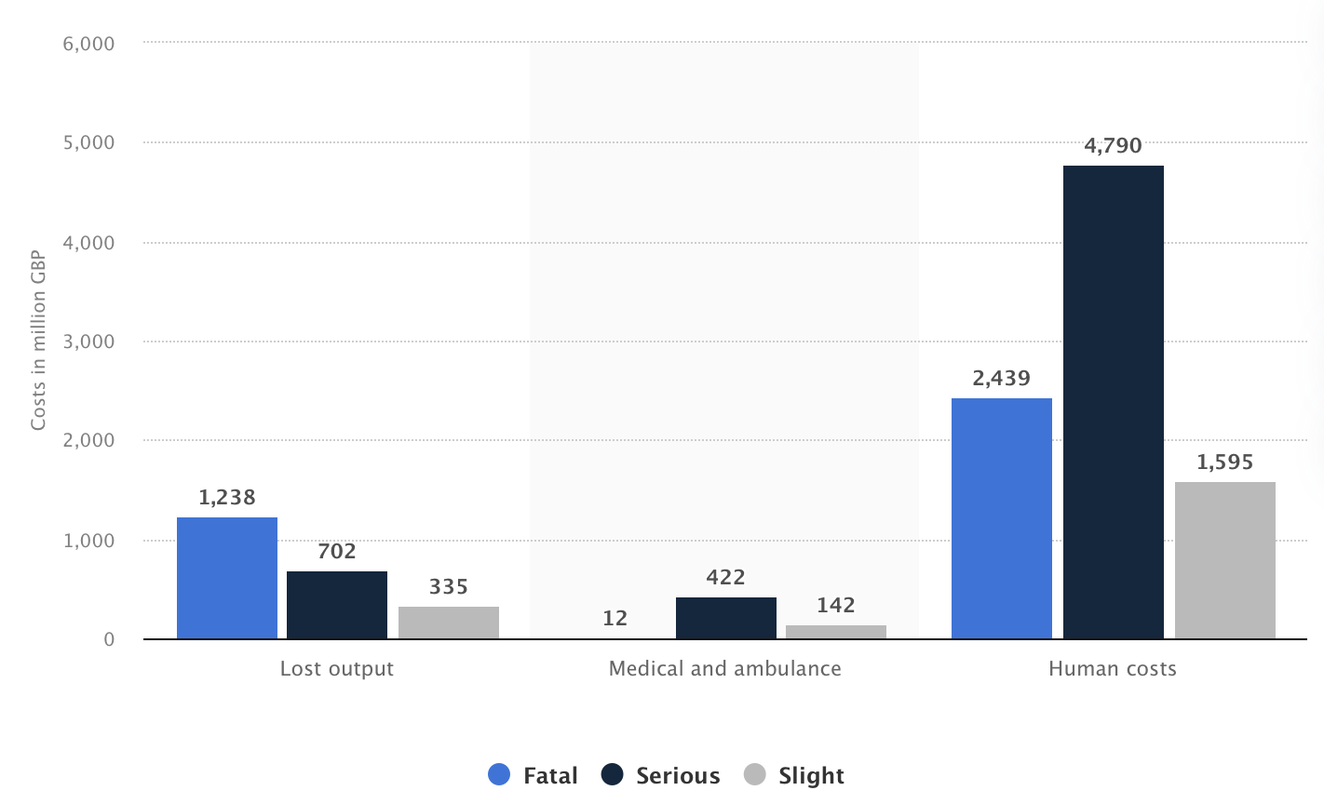
Business Problem
Road Accident Costs
Source: https://www.statista.com/statistics/325832/casualty-costs-from-road-accidents-in-great-britain-uk-by-severity/
Ethan

Slide 7


Business Problem
Current Measures
Education
Ethan

Slide 8
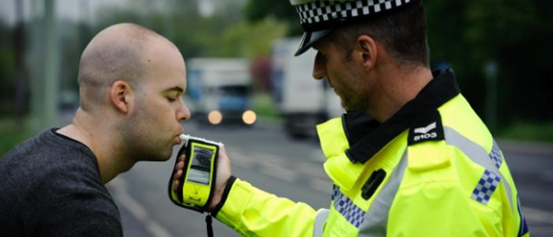
Business Problem
Current Measures
Police Enforcement
Ethan

Slide 9

Business Problem
Current Measures
Police Enforcement
Ethan

Slide 10
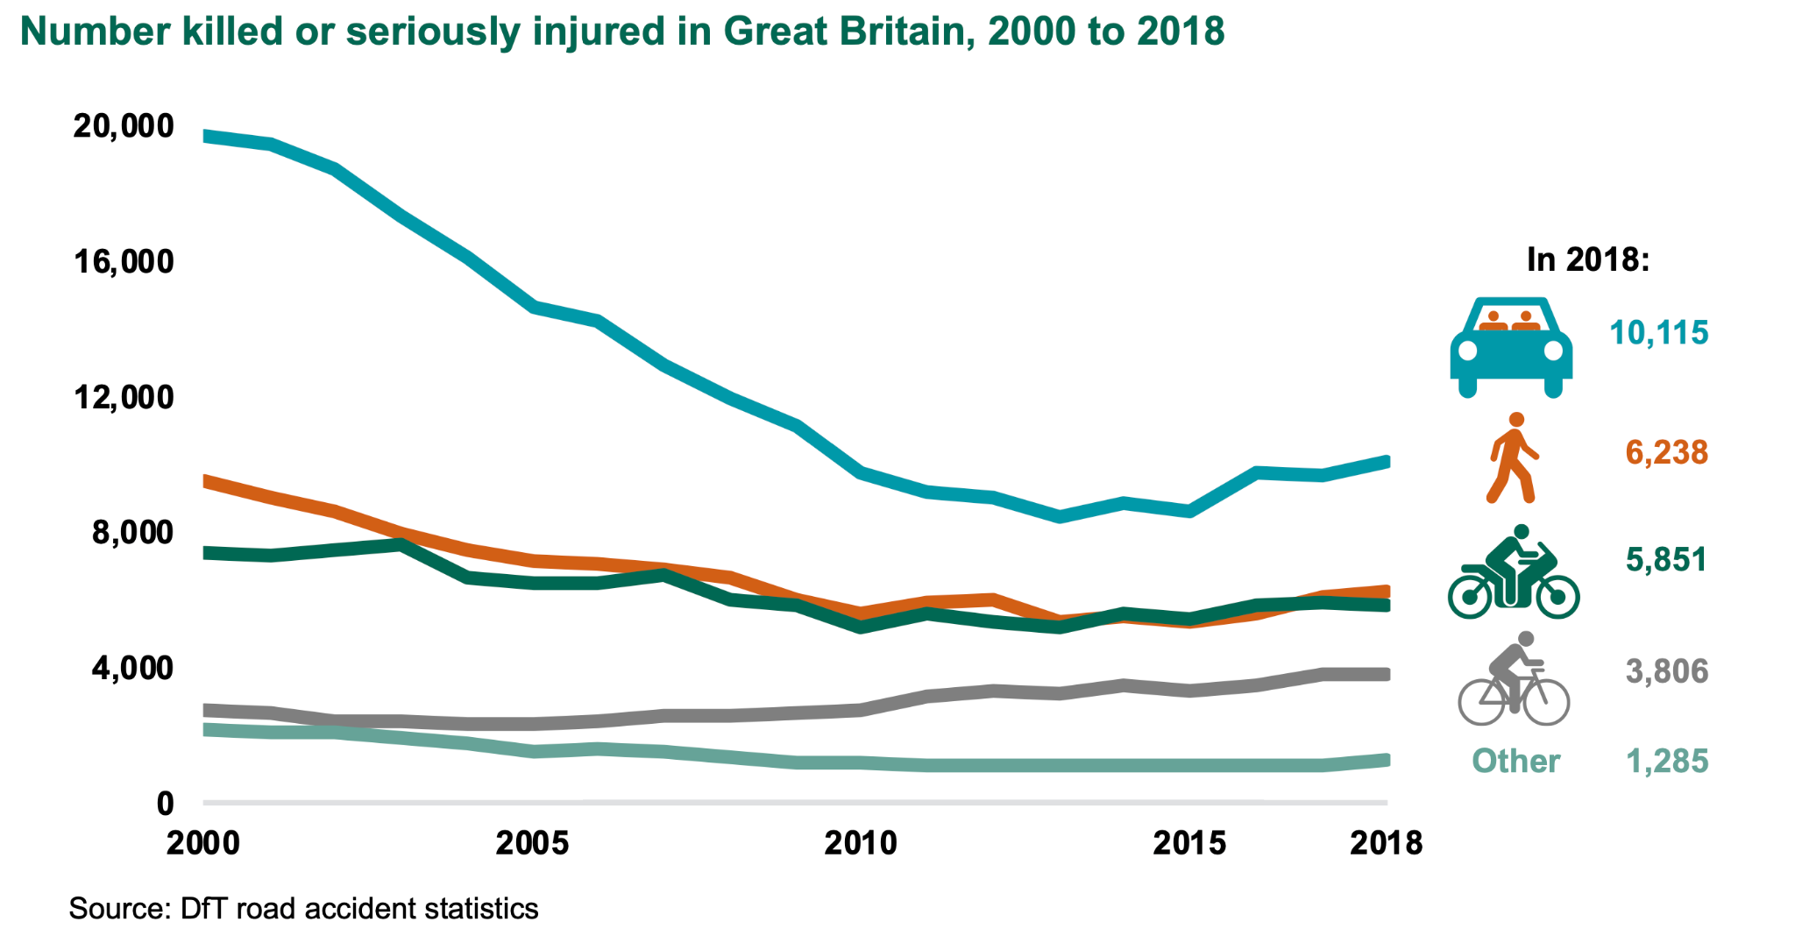
Business Problem
Road Accident Statistics
Ethan

Slide 11
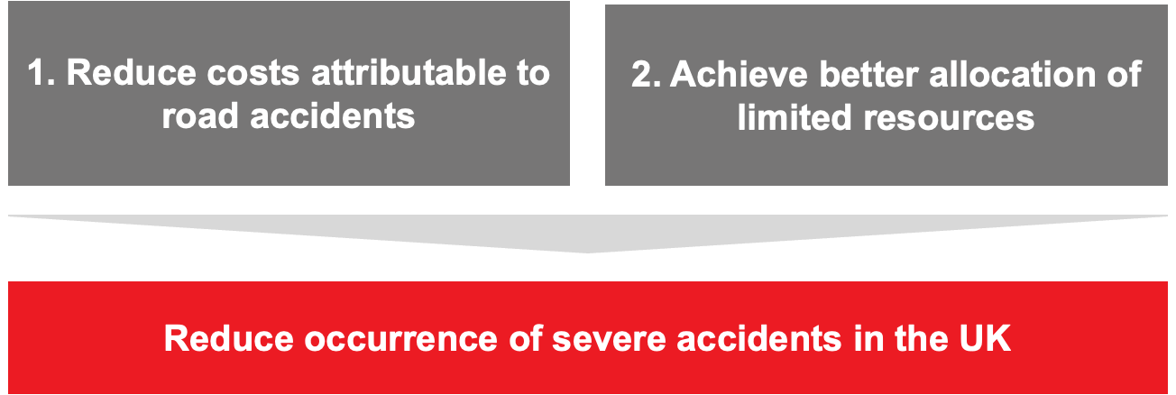
Business Objectives
Ethan

Slide 12
Analytics Solution
Key Business Questions
1. When and where do most serious accidents happen?
2. Can there be better traffic amenities and fixtures to reduce the risk of serious accidents?
3. Can we identify high risk drivers and casualties?
Ethan

Slide 13
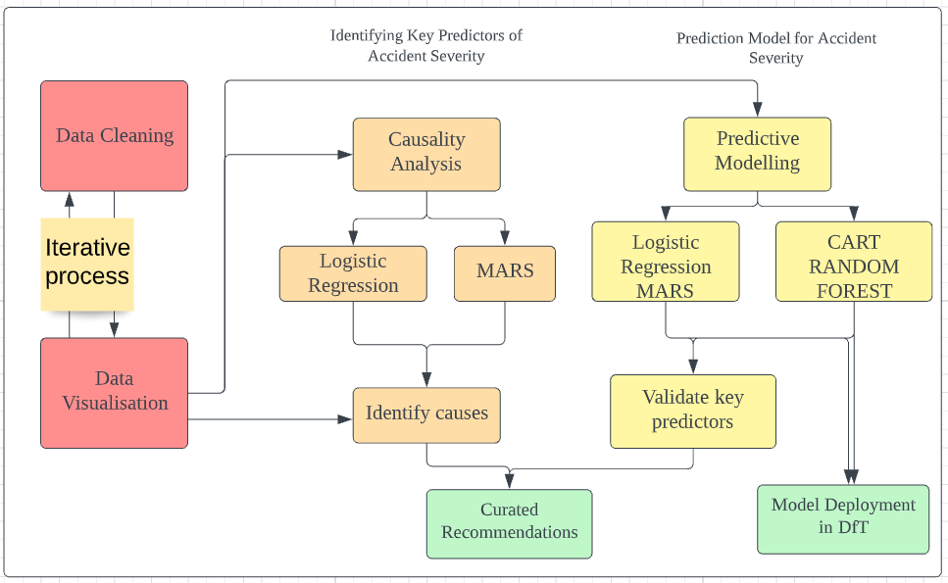
Analytics Solution
Ethan

Slide 14
What is Causality Analysis and why is it necessary?
Large number of predictor variables from 3 different datasets
Highly significant predictors
Logistic Regression
+ MARS
+ Expert Opinions
Joel

Slide 15

Logistic Regression
p-value
0.05
(significance of predictors)
If p-value lesser than or equal to 0.05, variable is significant
Joel

Slide 16
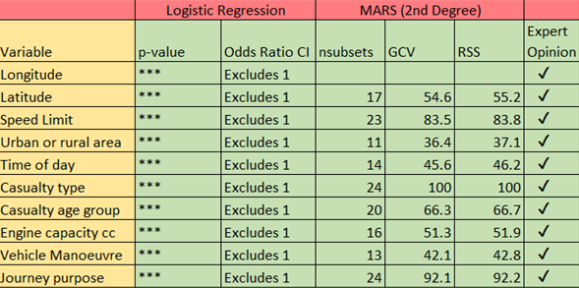
Evaluation Matrix for Key Predictors
Joel

Slide 17
Geographical Location (Latitude and Longitude)
Key Finding:
`local_authority_district` has an effect on accident severity
Districts with lower accident frequency have higher severity
Possible Explanation for Significance:
Rural areas have to wait longer for emergency response services
Joel

Slide 18
Urban or Rural Locality
Key Finding:
Higher likelihood of severe accidents occurring in rural areas compared to urban areas
Possible Explanation for Significance:
Rural areas have to wait longer for emergency response services
Joel

Slide 19
Casualty Age Group
Key Finding:
Seniors are more prone to severe accidents than non-severe accidents
Adults are less prone to severe accidents
Teenagers at higher risk of fatal accidents
Possible Explanation for Significance:
Seniors have slower response time compared to younger road users
Teenagers and young adults are more inexperienced road users
Joel

Slide 20
Speed Limit
Key Finding:
Probability of severe accidents is much higher at speed limits over 40km/h
Possible Explanation for Significance:
Every 8km/h increase in maximum state speed limit is associated with an 8% increase in mortality rates on highways (IIHS)
At higher speeds, there will be greater impact and damage in the event of a vehicular collision
Joel

Slide 21
Engine Capacity (cc)
Key Finding:
Vehicles with higher engine capacity have higher probability of being involved in fatal crashes
Possible Explanation for Significance:
More powerful vehicles are able to accelerate faster and travel at higher speeds
Speed is a strong predictor of accident severity
Joel

Slide 22
Time of the Day
Key Finding:
Higher percentage of severe accidents occur during non-peak hours at night compared to non- severe accidents
Possible Explanation for Significance:
Risk of fatal accident at night is three times higher compared to driving during the day (NHTSA)
Lower seat belt usage
Higher occurrence of speeding and drink-driving
Lower visibility
Drivers tend to be more drowsy at night
Joel

Slide 23
Casualty Type
Key Finding:
Cyclists, motorcyclists and pedestrians more likely to be involved in severe accidents
Possible Explanation for Significance:
No external protective device to absorb impact of road crash
These vehicles have lesser stability compared to other vehicles
Joel

Slide 24
Vehicle Manoeuvre
Key Finding:
Vehicles that perform overtaking manoeuvres have higher risk of severe accidents compared to non-severe accidents
More overtaking manoeuvre accidents involve larger sized vehicles (vans, trucks, etc.)
Possible Explanation for Significance:
Larger vehicles have more prominent blind spots
Overtaking is one of the most dangerous manoeuvres for drivers and riders (ROSPA, 2021)
Joel

Slide 25
Journey Purpose
Key Finding:
School or work related commutes have lower risk of serious accidents compared to those under the “other” category (e.g. leisure travel, etc.)
Possible Explanation for Significance:
Leisure travelers have higher likelihood of being involved in severe accidents
Leisure travelers more likely to exceed speed limits (Febres et al., 2019)
Leisure travelers more like to be easily distracted (Febres et al., 2019)
Joel

Slide 26
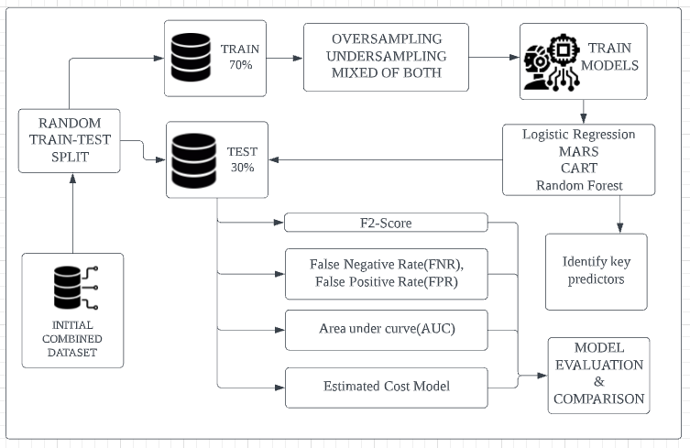
Overview of Prescriptive Techniques
Joel

Slide 27
Basis of Comparison - What do we look for in our models?
False Negative Rate (FNR)
Predicting -ve when +ve
False Positive Rate (FPR)
Predicting +ve when -ve
Area Under Curve (AUC)
F2 Score
Incorporates predictive accuracy and FN
Estimated Cost Model
Joel

Slide 28
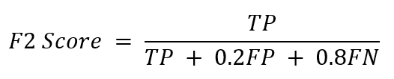
Most important - F2 Score
Measure of how well a model predicts outcome, factoring in FN
A variation of F1 score that places heavier weights on False Negatives (FN)
Higher FN count is penalized with a lower F2 score
Joel

Slide 29
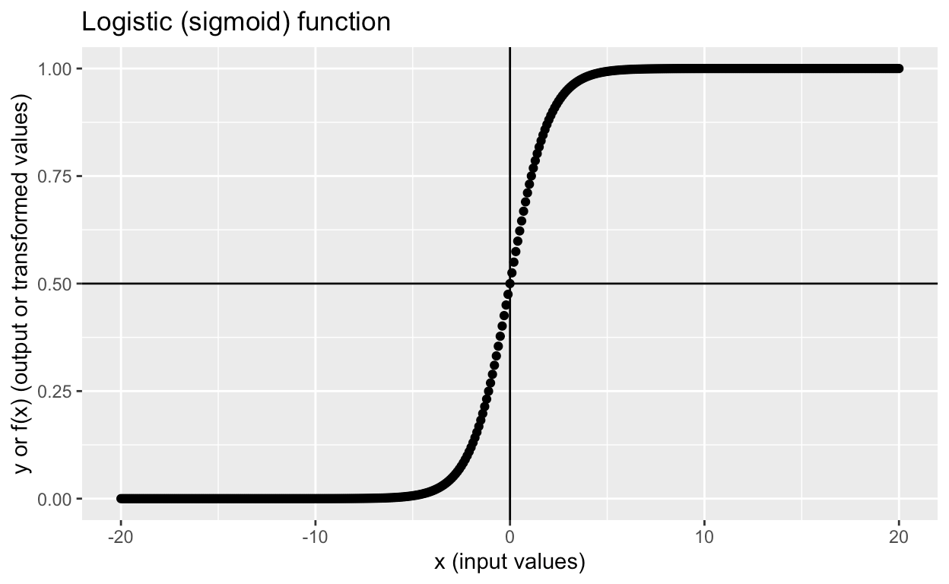
What is Logistic Regression?
Logistic Regression
Classifies categorical outcomes with a logit function
Output is log odds → Used to calculate probability
If probability > 0.5, outcome is classified as serious
Highly interpretable and explainable model
MARS
CART
Random Forest
Joel

Slide 30
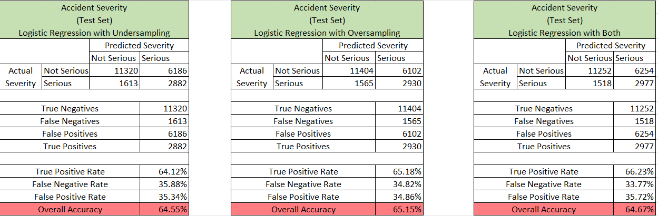
Logistic Regression Results Interpretation
Logistic Regression
MARS
CART
Overall test set accuracy of 64.55%, 65.15%, 64.67%
FNR decreased across the training sets
Hybrid test set has lowest FNR of 33.77%
Random Forest
Joel

Slide 31
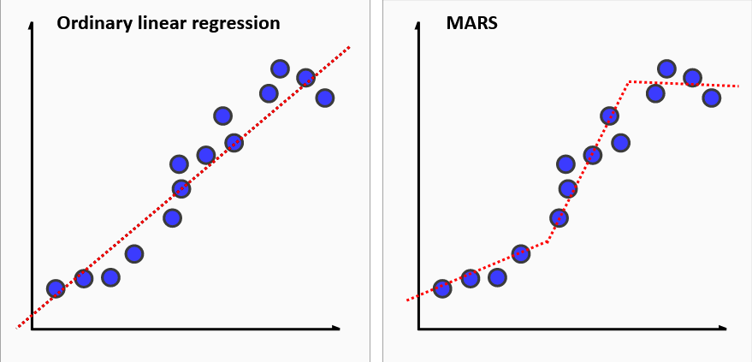
What is MARS?
Logistic Regression
Regression method useful for describing nonlinear relationships
Combination of linear functions with hinges
MARS finds the best hinge functions to split data such that it models broad trends
MARS
CART
Random Forest
Source: Kaggle
Joel

Slide 32
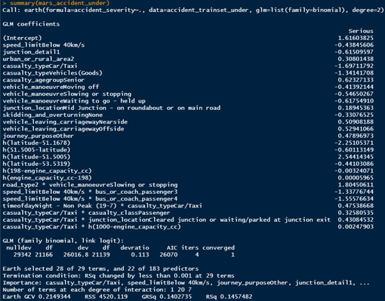
MARS Modelling
Logistic Regression
Degree = 2
Allows us to explore interaction effects between variables
Apart from degree, all other arguments are default
MARS
CART
Random Forest
Joel

Slide 33
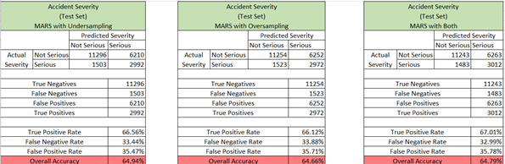
MARS Result Interpretation
Logistic Regression
MARS
CART
Overall test set accuracy of 64.94%, 64.66%, 64.79%
FNR roughly the same for all 3 models
Hybrid test set has lowest FNR of 32.99%
Random Forest
Joel

Slide 34
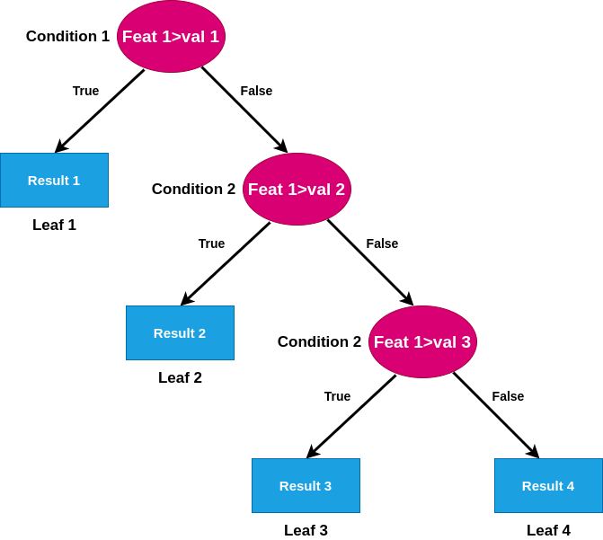
What is CART?
Logistic Regression
Using a rule-based approach to build a decision tree
Nodes are split using Gini impurity index
Result is a decision tree where each fork is a split in a predictor variable
Terminal node contains a prediction for the outcome variable
Useful for high interpretability
MARS
CART
Random Forest
Joel

Slide 35
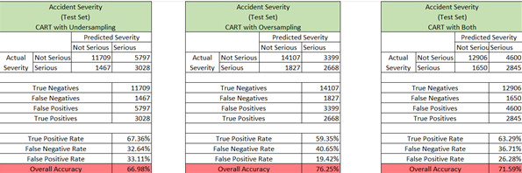
CART Result Interpretation
Logistic Regression
MARS
CART
Overall test set accuracy of 66.98%, 76.25%, 71.59%
FNR roughly the same for all 3 models
Under sampled test set has lowest FNR of 32.64%
Over sampled test set FNR is very high: 40.65%
Random Forest
Joel

Slide 36
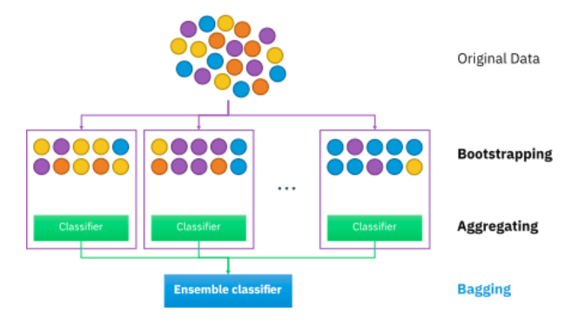
What is Random Forest?
Logistic Regression
Found to have the highest predictive accuracy
Leverages on the idea of Bootstrap Aggregating (Bagging)
MARS
CART
Random Forest
https://www.analyticsvidhya.com/blog/2021/06/understanding-random-forest/
Joshua
Notes:
Enter Random Forest, which we found to have the highest predictive accuracy. However to fully trust the model to make predictions, let us first take
A step back to understand what is Random Forest. It leverages on the idea of Bootstrap and Aggregating, hence the name bagging.

Slide 37
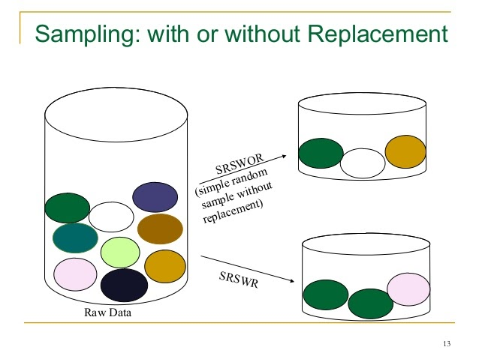
What is Random Forest?
Logistic Regression
Each decision tree built using different random samples with replacement
Trained independently
Step of replacement is called bootstrap
MARS
CART
Random Forest
https://samplingtechniquesmstat.blogspot.com/2020/12/selection-ofsamplessrswr-vs-srswor.html
Joshua
Notes:
In random forest, each decision tree is built using different random sample with replacement, that is a data point can appear in a sample multiple times.
The trees are then trained independently. This step of replacement is bootstrap.

Slide 38
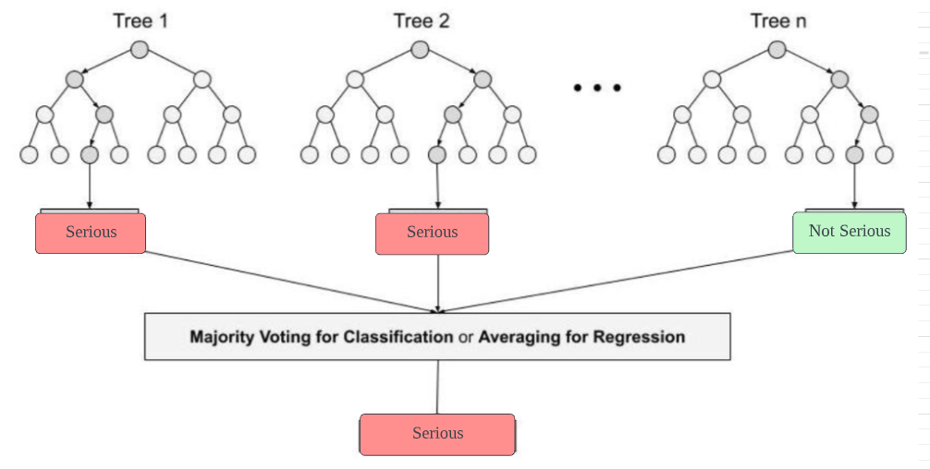
What is Random Forest?
Logistic Regression
Classification Problem “Serious” or “Not Serious”
Majority vote will be taken
Step of aggregation
Reduce single tree biasness (as seen in CART) -> no overfitting -> ability to predict unseen data well
MARS
CART
Random Forest
https://www.analyticsvidhya.com/blog/2021/06/understanding-random-forest/
Joshua
Notes:
After each decision tree is built with an independent sample, since this is a classification problem, a majority vote will be taken. This is the step of aggregating the result of all the trees. As seen here, if Serious is the majority vote our model will predict the accident to be severe. This reduces the single tree biasness which can be seen in CART, hence Random Forest does not overfit, meaning it can predict unseen data well.

Slide 39
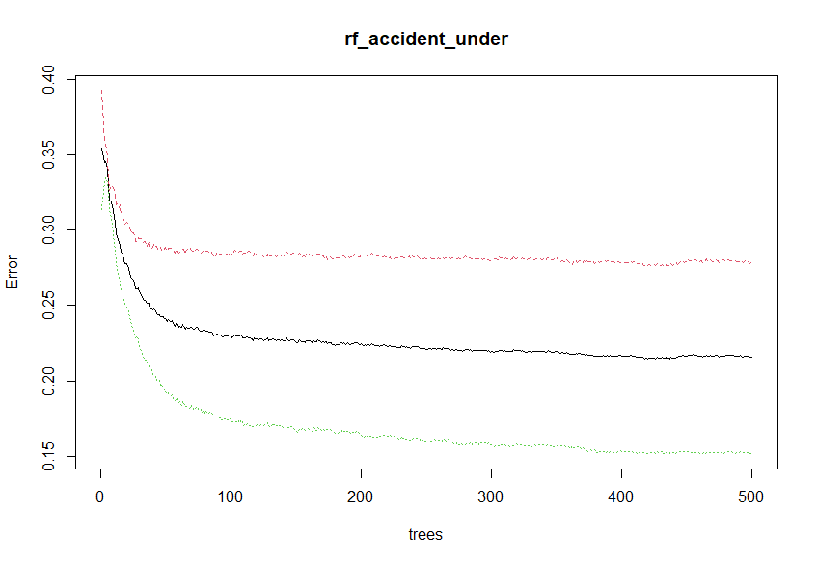
Random Forest Modelling
Logistic Regression
Various model parameters were tried
Mtry = number of predictors tried at each split
Ntrees = number of trees used to built the forest
Out of bag error stabilised after 100 trees were grown, showing that 500 trees were more than sufficient to build the model
OOB error refers to prediction errors of those left out of the sample used to train each tree
MARS
Model Parameters | Value
mtry | 9
ntrees | 500
The rest | Default
CART
Random Forest
Joshua
Notes:
Moving on to modelling, we tried various model parameters and converged on the following settings shown in the figure. We selected mtry = 9 which means 9 predictors were used at each split. From the right graph, we can see that the OOB errors stabilised after 100 trees were grown, showing that 500 trees were more than sufficient to build the model.
OOB error refers to prediction errors of left out samples used to train each tree.

Slide 40
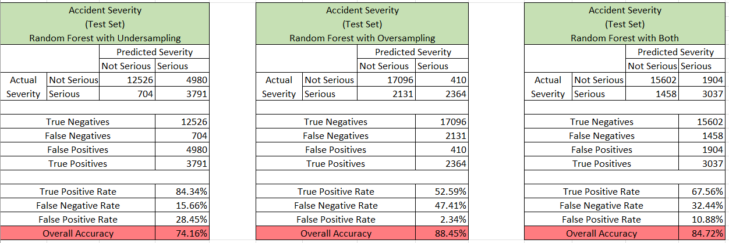
Random Forest Modelling
Logistic Regression
Random Forest is able to achieve a remarkable test set accuracies as shown in the diagram.
However, the model using oversampled data, has extremely high false negative rate of 50%.
This means that the model fails to identify a Serious accident 50% of the time, which is a concern.
MARS
CART
Random Forest
Joshua
Notes:
Random Forest is able to achieve superior test set accuracies compared to the other predictive problems. While the model with oversampled data, boasts a 88% accuracy, it has an extremely high FNR of 50%, meaning that the model fails to identify a Serious accident 50% of time, which is concerning. This will be further discussed later.

Slide 41
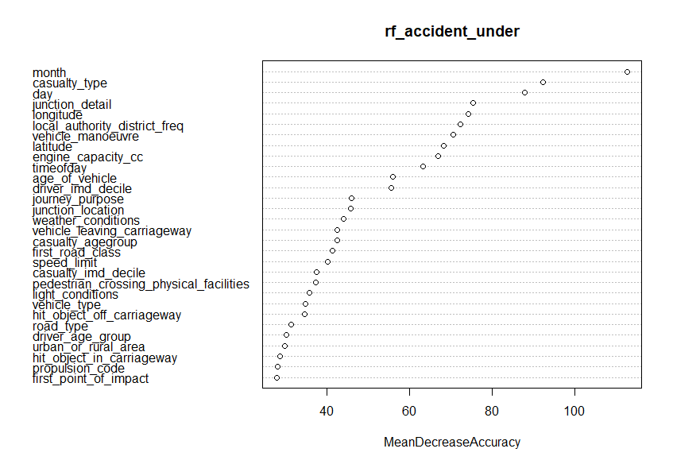
Random Forest Results Interpretation
Logistic Regression
Drawback: Black box nature
Difficult to interpret how predictors influence the predictions
RF has an in-built permutation feature importance to allow us to gain insights into powerful predictors.
MARS
CART
Random Forest
Joshua
Notes:
However, the drawback of Random Forest is it’s black box nature, making it difficult for users to interpret how predictors influence the predictions.
Thankfully, Random Forest has a built in permutation feature importance to allow us to gain insights into powerful predictors.

Slide 42
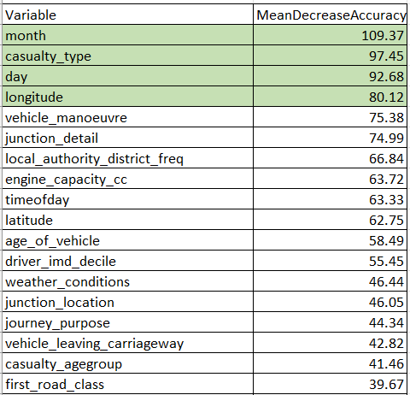

Random Forest Results Interpretation
Logistic Regression
Important features contain valuable information
Randomly shuffling values of this important information -> model accuracy fall
Decrease in accuracy is large -> predictors has great impact on predictions
Month, Casualty Type, Day and Geographical Coordinates are the most important predictors of accident severity as they result in the greatest mean decrease in accuracy when its information is randomly shuffled.
MARS
CART
Random Forest
https://towardsdatascience.com/from-scratch-permutation-feature-importance-for-ml-interpretability-b60f7d5d1fe9
Joshua
Notes:
Of course, it is important to know how importance of features is derived, so let me explain briefly. Basically important features contain valuable information. When valuable information is randomly shuffled, accuracy is expected to fall. If the decrease in accuracy is large, it means predictors have great impact on predictions.
For the ease of interpretation, I have summarised the earlier graph into the table, where we can see month, casualty type, day and geographical coordinates are the most important predictors identified by random forest as they result in the greatest mean decrease in accuracy.

Slide 43
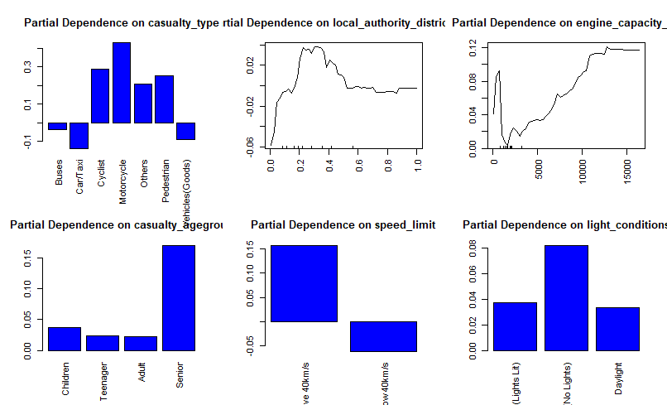
Random Forest Results Interpretation
Study Partial Dependence Plots
The class of interest here is “Serious Accidents”
For example, the probability of serious accidents rise sharply when engine capacity exceeds 5000cc.
In addition, the probability of serious accidents are much higher when it is night time and the street lamps are off.
These plots further support the root causes identified earlier.
Random Forest
https://christophm.github.io/interpretable-ml-book/pdp.html
Joshua
Notes:
We can also study the partial dependence plots for greater insights, with serious accidents being the class of interest. For example, the probability of serious accidents rise sharply when engine capacity exceeds 5000c. These plots further supports the root causes identified by Joel earlier, increasing credibility of our root cause analysis.

Slide 44
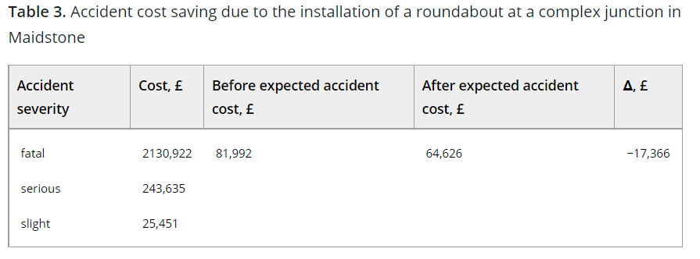
Model Evaluation
Logistic Regression
Economic value estimation models: Accidents cost savings due to preventive measure can be up to 21% Arbitrary FPR cost is 21% of FNR cost
MARS
Expected Cost = (FNR + 0.79FPR) £64,626
CART
Random Forest
https://ietresearch.onlinelibrary.wiley.com/doi/10.1049/iet-its.2020.0093
Joshua
Notes:
In addition to various machine learning specific metrics, we found that accident cost savings due to preventive measures is approximated to be 21% and came up with the following expected cost model. The model here places greater weight on false negative rates by 21%.

Slide 45
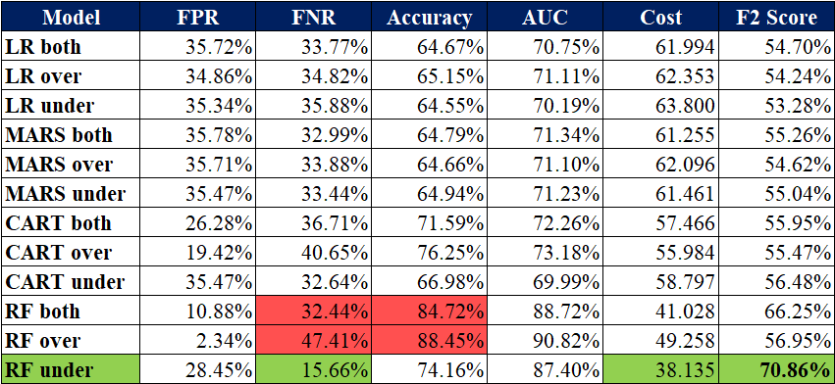
Model Evaluation
Logistic Regression
Model chosen: Random Forest with Undersampling of train set
MARS
CART
Random Forest
https://machinelearningmastery.com/fbeta-measure-for-machine-learning/#:~:text=The%20choice%20of%20the%20beta,F0.
Joshua
Notes:
A summary of results are shown here. I would like to draw your attention to the model accuracies, it can be seen that random forest with oversampling or a mixture are able to achieve very high accuracies. However, they have incredibly high false negative rates, which is certainly a concern. The cost of false negatives here are far superior, hence, Random Forest with undersampling was chosen as the predictive model of choice. As we can see, it has a false negative rate of more than half the other models, the lowest economic cost and highest F2 score. The F2 score prioritises minimising false negatives, and is hence the more reliable metric for our business problem.

Slide 46
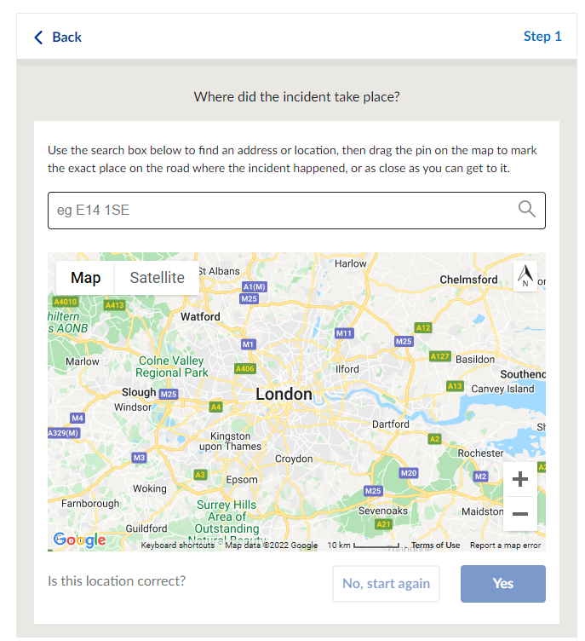

Community Centric Hazard Sharing Application
Current accident reporting system:
Requires visiting website
Entering geographical coordinates
Not convenient nor user friendly for drivers
Information only routed to government
https://www.met.police.uk/ro/report/rti/rti-beta-2.1/report-a-road-traffic-incident/
Joshua
Notes:
Machine Learning is just a tool to for us to test our ideas, the bigger question is how can we use analytics insights derived from our model to reduce traffic accident severity. Firstly, we recommend a community centric hazard sharing application. Current accident reporting in the UK requires visiting webpages which is not convenient for drivers and furthermore, information is only routed to the government.

Slide 47


Community Centric Hazard Sharing Application
Proposed solution:
Allow open-reporting of hazards of traffic conditions through an application
Done with a simple click of a button
Government and road users can receive real-time updates
Joshua
Notes:
Enter Ping, an application to allow open-reporting of hazards through an application done with a simple click of a button. The government and road users can receive real-time updates based on road users feedback.

Slide 48

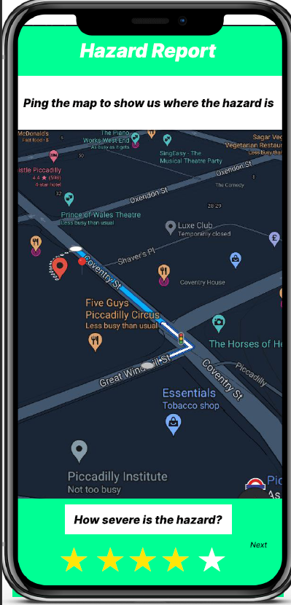
Community Centric Hazard Sharing Application
Benefit:
Government can promptly react and provide appropriate remedial measures
Especially important to remedy root causes identified
Example: Lightings at Night
Save the government cost and time of scheduled inspections
Joshua
Notes:
Our analytics insights

Slide 49
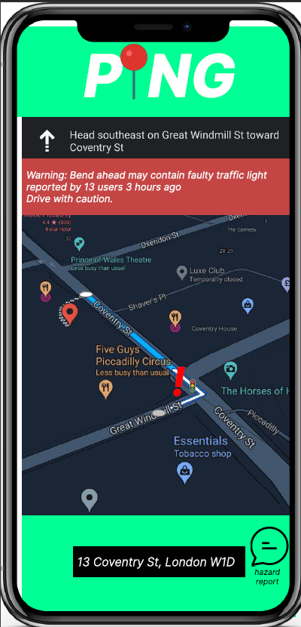


Community Centric Hazard Sharing Application
Benefit:
Real-time update to warn other road users of potential dangers
Allows drivers to reroute if possible
No delay in transfer of information
Warn drivers of hotspots to increase driver vigilance.
Joshua

Slide 50

Recommendations to tackle Root Causes
Make improvement to traffic fixtures at accident hotspots identified to reduce accident severity
Hazard Sharing Application
Why :
Certain accident hotspots have higher rate of accidents severity due to deficiencies in infrastructure
Upgrading Traffic Fixtures at Accident Hotspots
Types of improvement:
Adding countdown timer to traffic lights
Studies show traffic lights with countdown timers increase the likelihood of vehicles coming to a complete stop
Install more traffic cameras at locations with higher speed limit
Models identified higher speed limit have higher likelihood of severe accidents
Traffic cameras discourage drivers from speeding and reduce severe accidents
Legislative Amendments
Increasing frequency of road inspections
Efficient emergency response service
Enhance traffic regulations and discourage dangerous road behaviour at accident hotspot
He Ying

Slide 51

Recommendations to tackle Root Causes
Hazard Sharing Application
Revise existing traffic laws and implement new laws
Why:
Aggressive traffic enforcement reduces the number of vehicle crashes through deterrence
Upgrading Traffic Fixtures at Accident Hotspots
Revise existing law :
Reducing speed limits
Models identified higher speed limit have higher likelihood of severe accidents
Research shows that reducing speed limits could reduce accidents and reduce frequency of severe accidents
Implementing new law:
Harsher penalty on those with higher class vehicles
Model identified higher engine capacity have higher likelihood of severe accident → tend to accelerate faster
Eg. Imposing higher penalty points on Class A motorcycles (high engine capacity and power) when they violate speed limit
Legislative Amendments
Increasing frequency of road inspections
Efficient emergency response service
He Ying

Slide 52

Recommendations to tackle Root Causes
Mandate local authorities to conduct scheduled road inspections at identified accident hotspots
Hazard Sharing Application
Why:
Allow for prompt detection of problems and potential hazards
Upgrading Traffic Fixtures at Accident Hotspots
Inspections:
Semi annual inspections
Detect problems such as damaged or stolen signage especially the smaller roads in rural areas which are seldom inspected and maintained
Detect general damage to road surfaces such as potholes →Road surfaces deteriorate on a daily basis
Detect and fix road faults efficiently can reduce accidents from occurring
Inspect and install street lights
Analysis show that higher percentage of serious accidents occur during non-peak hours at night
Lack of street lights in rural areas could lead to more severe accidents →consider installing all-in-one solar street lights that use energy recycled with solar panels to power lights at night - which is more cost efficient
Legislative Amendments
Increasing frequency of road inspections
Efficient emergency response service
He Ying

Slide 53

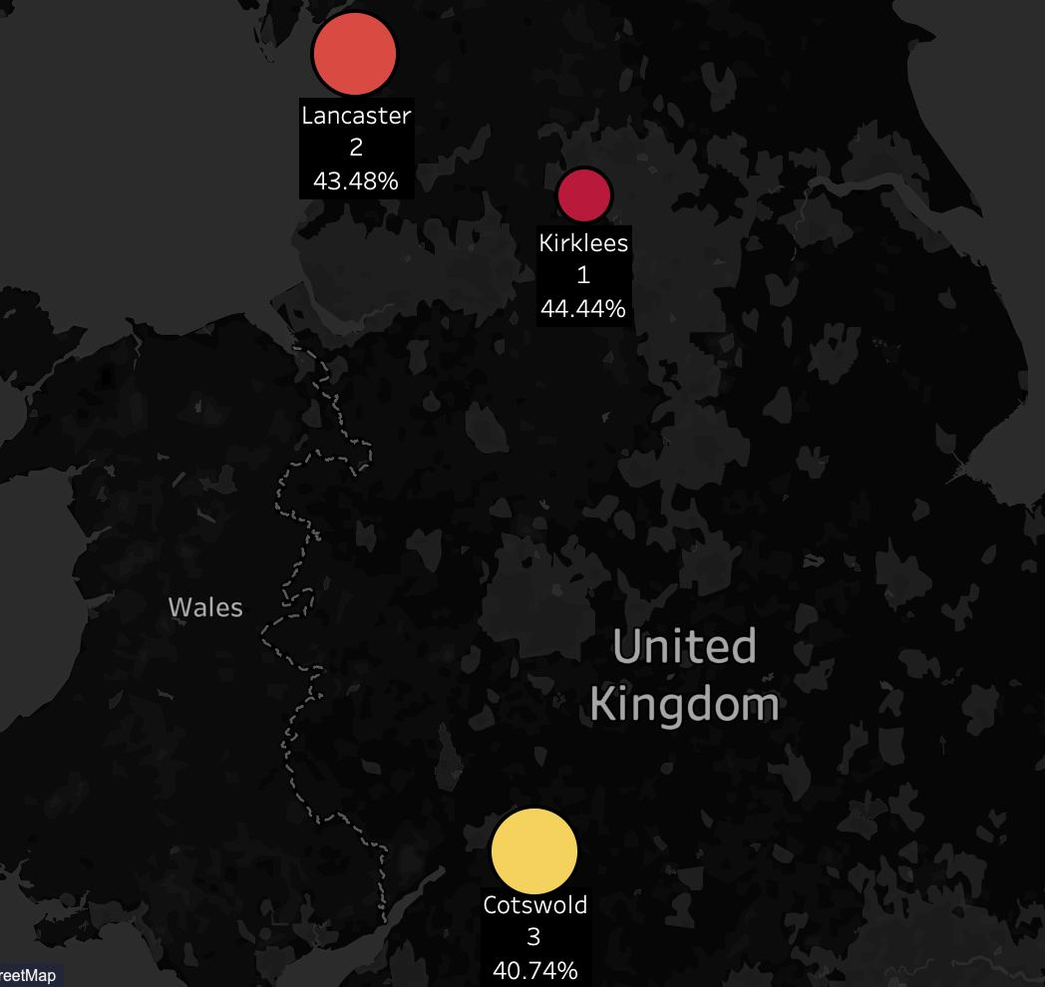
Recommendations to tackle Root Causes
Hazard Sharing Application
Strategic deployment of emergency response service using analytics
Why:
Alarming delay in current emergency response times
Upgrading Traffic Fixtures at Accident Hotspots
Strategic deployment based on the identified accident hotspots
Accident hotspots are identified through analytics
Strategic deployment reduce arrival timing of paramedics, reducing traffic fatalities
Legislative Amendments
Increasing frequency of road inspections
Top 3 severe accident hotspots identified are Kirklees, Lancaster and Cotswold
Efficient emergency response service
He Ying

Slide 54

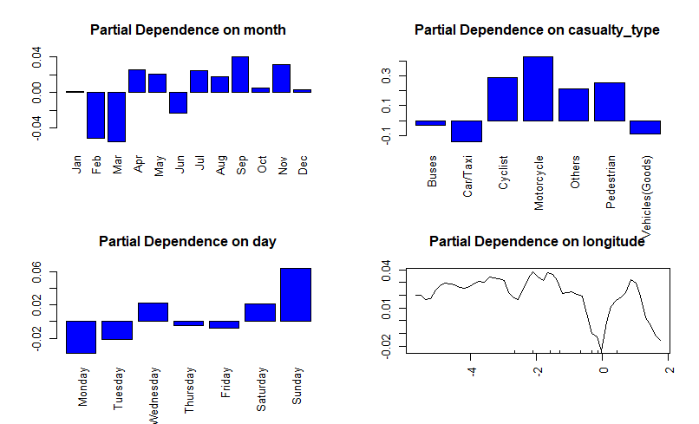
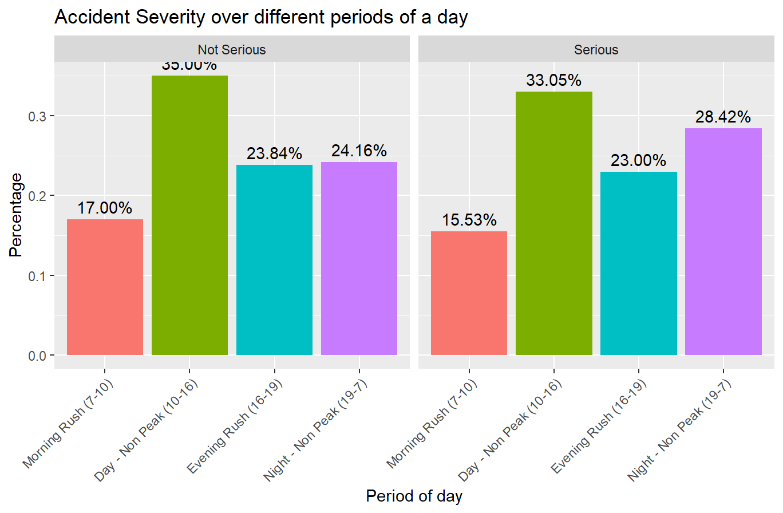
Recommendations to tackle Root Causes
Hazard Sharing Application
Strategic deployment of emergency response service using analytics
Upgrading Traffic Fixtures at Accident Hotspots
Strategic deployment based on the timing with higher probability of severe accident
Weekends have higher probability of severe accidents
Night time have higher probability of severe accidents
Legislative Amendments
Increasing frequency of road inspections
Efficient emergency response service
He Ying

Slide 55
Strengths and Limitations of Analytics Solution
Strengths
Limitations
Due to class imbalance our team utilised naive sampling technique
This sampling method assume nothing about the data and no heuristics were used reducing accuracy of model
Predictive models were built using past data
Road traffic accident data is dynamic and may become obsolete over time
Therefore, retraining using new data is necessary
Models are assessed to be a good predictor of identifying “Serious” accidents due its low false negative rate
Identifying important factors ensure efficient allocation of resources
Model accuracy rates can be improved through using more advanced techniques like deep learning
He Ying

Slide 56

Conclusion
Advancement in technology presents an opportunity for the UK government
Proposed analytics solution provides key insights on measures that can be taken
Government should consider these recommendations to take pre-emptive and corrective actions to reduce severe accidents
Critical to assess and improve the long-term viability of the presented recommendations
Department of Transport should constantly update its models to ensure predictive accuracy
He Ying

Slide 57
Thank You
Q&A

Slide 58
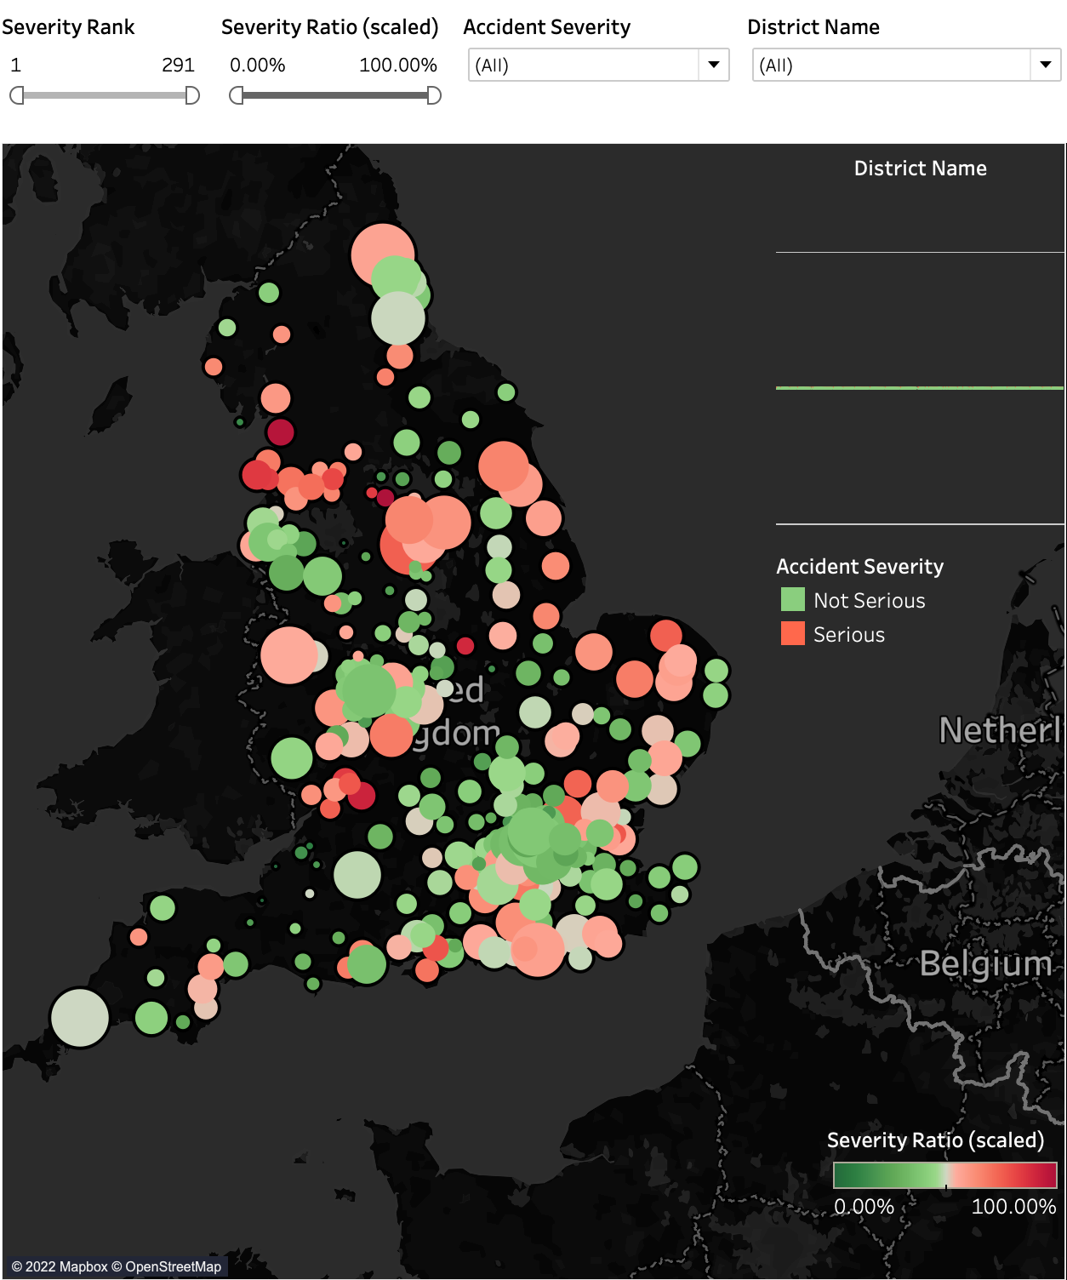
Appendix
Dashboard Visuals
Dashboard 1 - Accident Hotspots in UK
Points on map indicate district in UK
Size of points represent number of accidents in the district
Colour scale indicates the percentage of severe accidents over the total accidents recorded in each district. ( Severity Ratio is rescaled to 0 - 100 scale for easier referencing)
Red - Higher likelihood of severe accidents occurring in district
Brandon

Slide 59
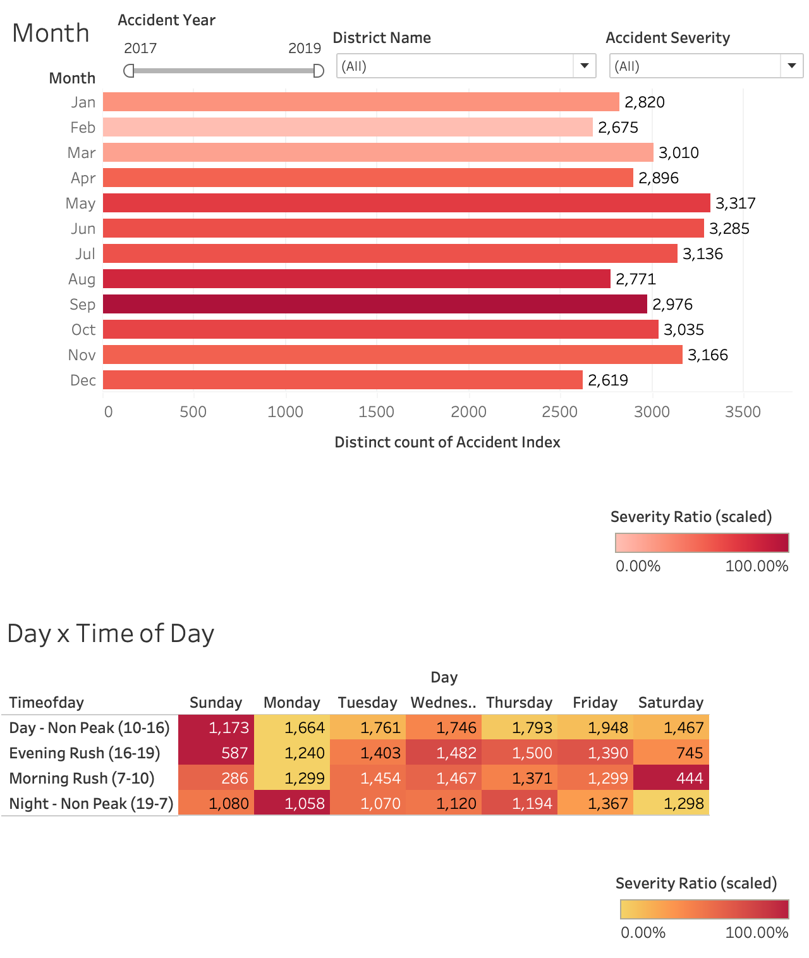
Appendix
Dashboard Visuals
Dashboard 2 - Accidents over Time
Figure (Top)
Above figure represents total accidents recorded in each month
Length of bar indicates total number of accidents each month
Colour scale represents percentage of severe accidents over the total accidents recorded in each month.
( Severity Ratio is rescaled to 0 - 100 scale for easier referencing )
Red - Higher likelihood of severe accidents occurring in month
Brandon

Slide 60
Appendix
Dashboard Visuals
Dashboard 2 - Accidents over Time
Figure (Bottom)
Bottom figure represents total accidents recorded in for each day and time of day.
Each cell represents total accidents recorded for respective day and time of day.
Colour scale represents percentage of severe accidents over the total accidents recorded in each month.
( Severity Ratio is rescaled to 0 - 100 scale for easier referencing )
Brown - Higher likelihood of severe accidents occurring within day and time of day
Brandon

Slide 61
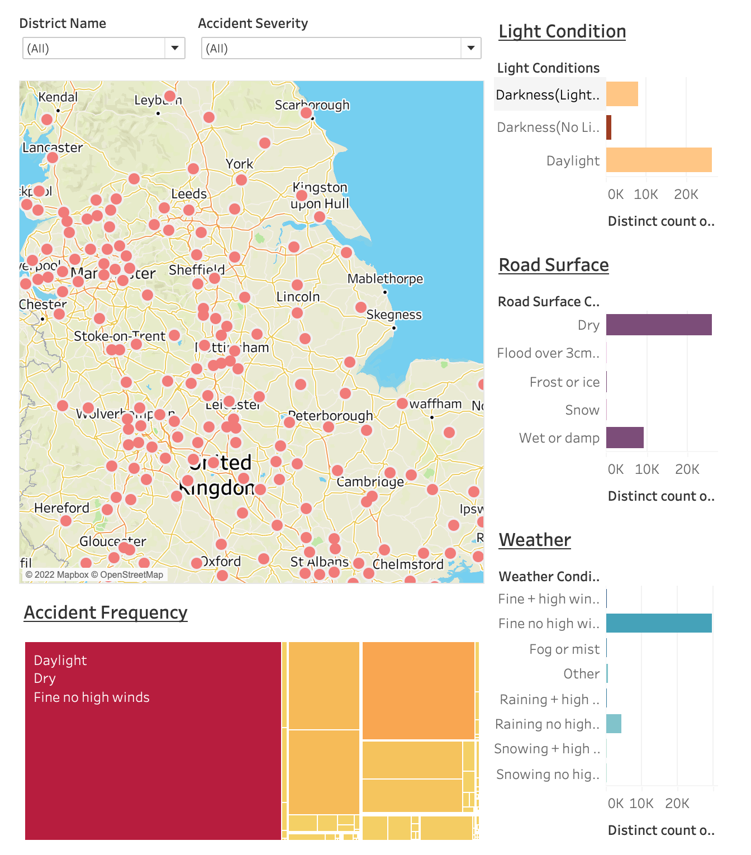
Appendix
Dashboard Visuals
Dashboard 3 - Environmental Conditions and Accidents
Map
Point represents location of each district in UK.
Figures (Right)
Each plot represents the environmental conditions in which the accident occurs. Light , Road Surface and Weather conditions. (top to bottom)
Length of bar represents the total number of accidents that occur under respective conditions.
Colour scale represents percentage of severe accidents over the total accidents recorded in respectoive environmental condition.
Brown/Purple/Blue - Higher likelihood of severe accidents occurring
Brandon

Slide 62
Appendix
Dashboard Visuals
Dashboard 3 - Environmental Conditions and Accidents
Figure (Bottom)
Cell represents total number of accidents recorded for combined environmental conditions.
Size of cell indicates total number of accidents recorded for combined weather condition.
Colour scale represents total number of accidents recorded for combined environmental condition.
Brown - Higher records of accidents occurring for combined environmental condition
Brandon

Slide 63
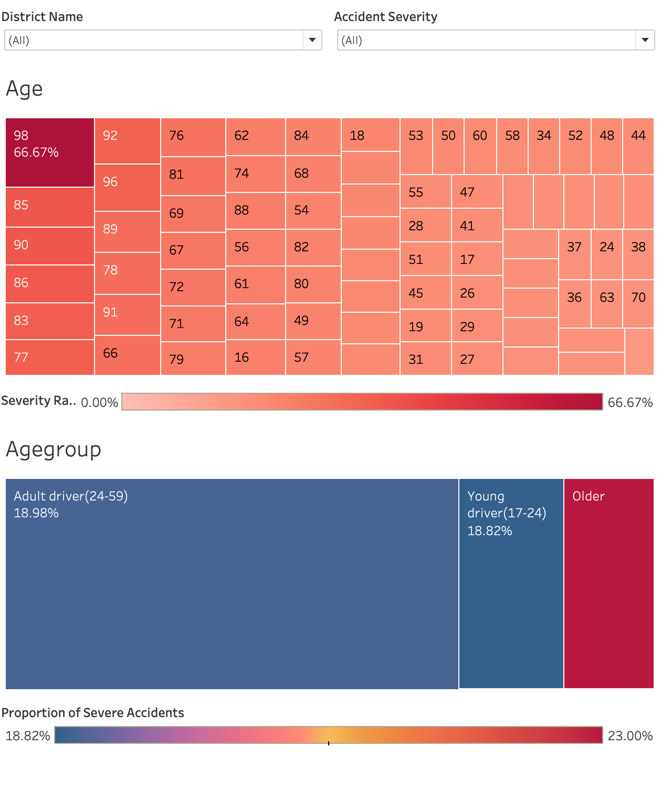
Appendix
Dashboard Visuals
Dashboard 4 - Demographic and Severe Accidents
Figure (Top)
Cell represents age of driver for recorded accident.
Size of cell indicates likelihood of age of driver involved in severe accidents over total number of accidents recorded for same age.
Colour scale represents percentage of severe accidents over the total accidents recorded for each age
Red - Higher likelihood of severe accidents occurring for age.
Brandon

Slide 64
Appendix
Dashboard Visuals
Dashboard 4 - Demographic and Severe Accidents
Figure (Bottom)
Cell represents age band of driver for recorded accident.
Size of cell indicates likelihood of driver age band involved in severe accidents over total number of accidents recorded for same age band.
Colour scale represents percentage of severe accidents over the total accidents recorded for each age band
Red - Higher likelihood of severe accidents occurring for age band.
Brandon

